Slide 1

Introduction to the TC3xx Ethernet domain
Pavel-Ioan Duta (IFAG ATV MC TM CES1)
July 2024

Slide 2
Table of contents
1
TC3xx available boards
3
2
Introduction to the TC3x GETH module
5
2.1
Brief description of the GETH module
6
2.2
GETH Master/Slave AHB
12
2.3
Descriptors
14
2.4
Transmit Descriptors
21
2.5
Receive Descriptors
28
2.6
MAC Transaction Layer (MTL)
34

Slide 3
Table of contents
1
TC3xx available boards
3
2
Introduction to the TC3x GETH module
5
2.1
Brief description of the GETH module
6
2.2
GETH Master/Slave AHB
12
2.3
Descriptors
14
2.4
Transmit Descriptors
21
2.5
Receive Descriptors
28
2.6
MAC Transaction Layer (MTL)
34

Slide 4
TC3xx available boards
Automotive Gateway V2 – it contains two TC397 – RGMII connection between a TC397 GETH module and a Realtek RTL9047AA switch and between the switch and a Realtek RTL8211F Ethernet PHY;
Lite Gateway V1.0 – it contains a TC377 - RGMII connection between a TC377 GETH module and a Broadcom BCM89559G Switch and between the switch and a Broadcom BCM89610 Ethernet PHY - NDA required!
Secure Gateway V1.1 – it contains a TC377TX* - RGMII connection between a TC377TX GETH module and a Marvell 88Q5050 Switch and an SGMII connection between the switch and a Marvell 88Q2112 Ethernet PHY - NDA required!
TC3X7 Application Kit – it can contain TC397, TC387, TC377, TC367 or TC3E7 – RGMII connection between the TC3X7 GETH module and a Realtek RTL8211F Ethernet PHY;
AURIX™ lite Kit V2 – it can contain TC375, TC365, TC275** or TC265** – RMII connection between the Aurix Ethernet domain and a Texas Instruments DP83825I Ethernet PHY;
TC3XX Triboards – it can contain TC3X2, TC3X3, TC3X4, TC3X5, TC3X6, TC3X7 and TC3X9 – RGMII connection between the TC3XX GETH module and a Realtek RTL8211F Ethernet PHY;
* TC377TX is the only Aurix 2G that has two GETH modules;
** TC2XX does not have gigabit capabilities. Only MII and RMII are available;

Slide 5
Table of contents
1
TC3xx available boards
3
2
Introduction to the TC3x GETH module
5
2.1
Brief description of the GETH module
6
2.2
GETH Master/Slave AHB
12
2.3
Descriptors
14
2.4
Transmit Descriptors
21
2.5
Receive Descriptors
28
2.6
MAC Transaction Layer (MTL)
34

Slide 6
Table of contents
1
TC3xx available boards
3
2
Introduction to the TC3x GETH module
5
2.1
Brief description of the GETH module
6
2.2
GETH Master/Slave AHB
12
2.3
Descriptors
14
2.4
Transmit Descriptors
21
2.5
Receive Descriptors
28
2.6
MAC Transaction Layer (MTL)
34

Slide 7
Introduction to the TC3x GETH module
The TC3x GTH module is described in the second part of the TC3x family User Manual, in chapter 44 Gigabit Ethernet MAC (GETH);
DWC_ether_qos is the name of the Ethernet IP that is implemented in all TC3x. The IP provider is Synopsys;
DWC_ether_qos and GETH refer to the same block;

Slide 8
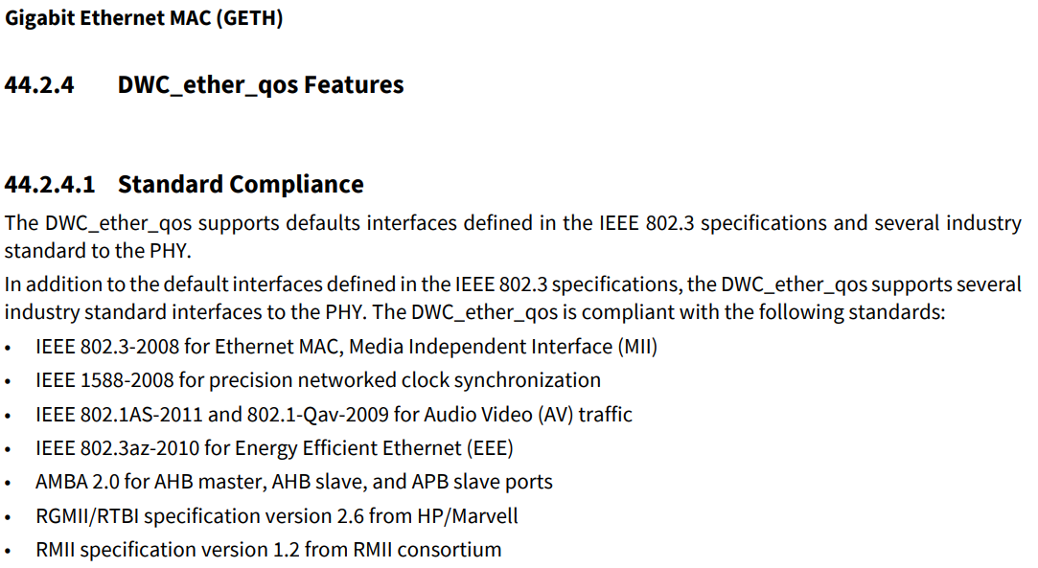
Introduction to the TC3x GETH module

Slide 9
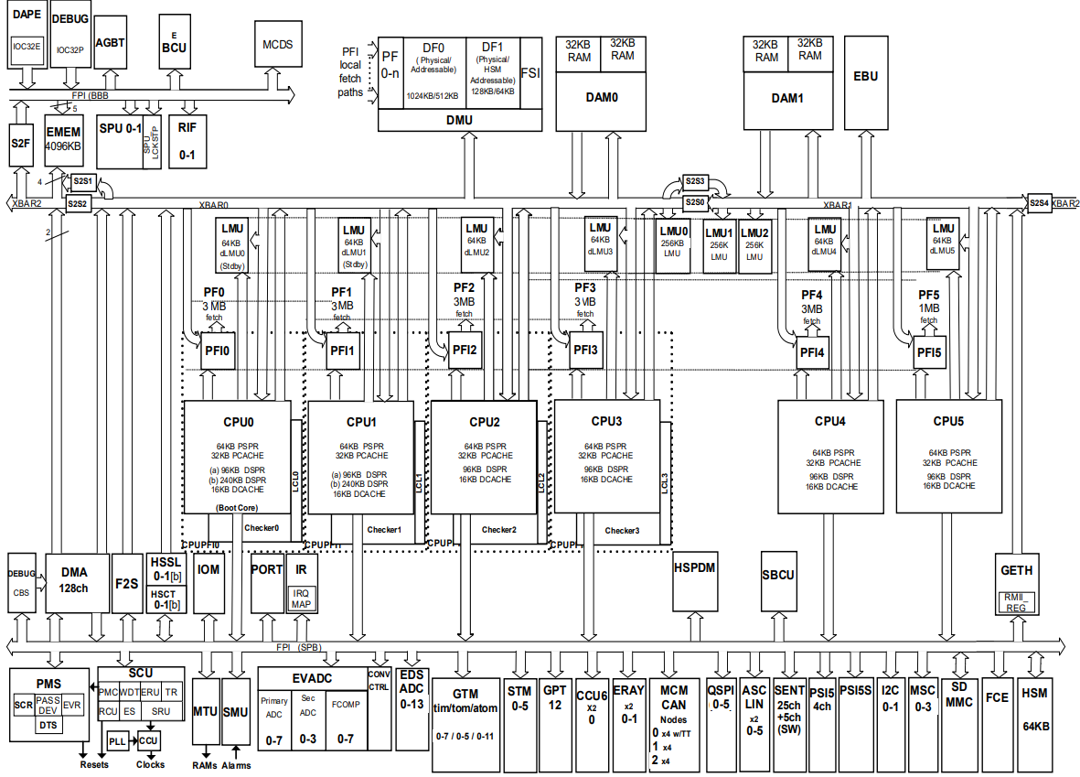
Introduction to the TC3x GETH module

Slide 10
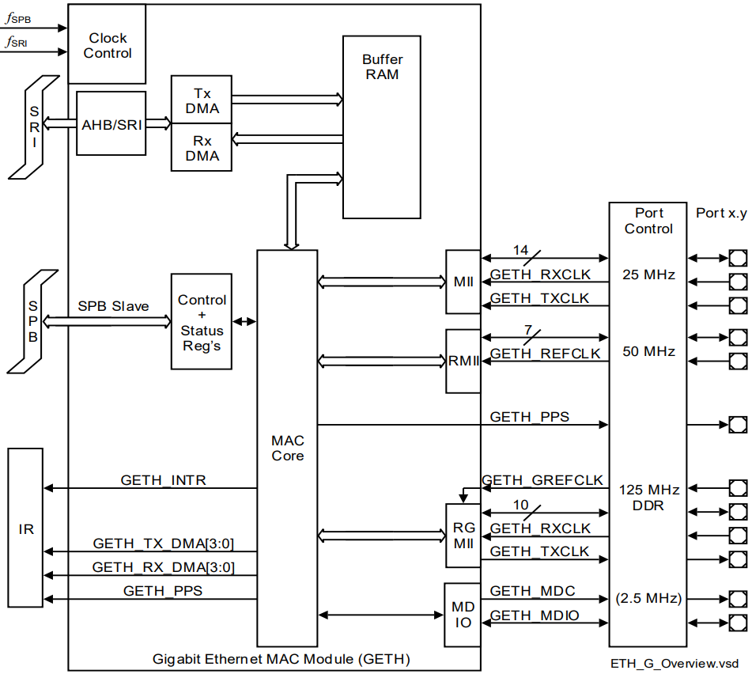
Introduction to the TC3x GETH module

Slide 11
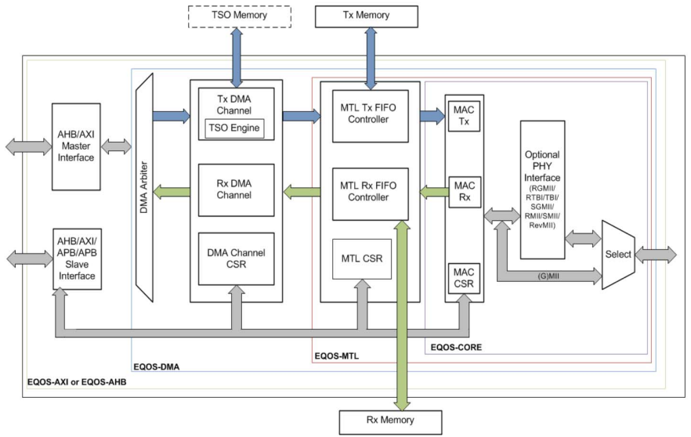
Introduction to the TC3x GETH module

Slide 12
Table of contents
1
TC3xx available boards
3
2
Introduction to the TC3x GETH module
5
2.1
Brief description of the GETH module
6
2.2
GETH Master/Slave AHB
12
2.3
Descriptors
14
2.4
Transmit Descriptors
21
2.5
Receive Descriptors
28
2.6
MAC Transaction Layer (MTL)
34

Slide 13
Introduction to the TC3x GETH module
The AHB interface transfers the data to and from system memory through the AHB master interface. When the AHB interface is selected, the host CPU uses the default 32-bit AHB slave interface to access the Control and Status registers (CSRs) of the DWC_ether_qos subsystem;
The GETH kernel IP supports various burst length of 1 up to 32 beats. TC3x supports only the following burst lengths: SINGLE, INCR4, INCR8. INCRx means 1 transfer of x bytes;
The AHB master can initiate transfers of unspecified length (INCR) or SINGLE transfers that are not supported by TC3x since the SRI needs a fixed burst length;
The AHB master interface can align all AHB burst transfers to an address value;
The SRI is a 64 bit wide bus and in order to make full use of the possible performance of SRI and its bridges, the data buffers and the descriptors need to be aligned to 64 bit addresses;
In order to achieve the above requirements, DMA_SYSBUS_MODE. FB and DMA_SYSBUS_MODE. AAL bits must be set;

Slide 14
Table of contents
1
TC3xx available boards
3
2
Introduction to the TC3x GETH module
5
2.1
Brief description of the GETH module
6
2.2
GETH Master/Slave AHB
12
2.3
Descriptors
14
2.4
Transmit Descriptors
21
2.5
Receive Descriptors
28
2.6
MAC Transaction Layer (MTL)
34

Slide 15
Introduction to the TC3x GETH module
The data structures that the GETH DMA uses are called descriptors;
The application creates the descriptors in the system memory;
The DWC_ether_qos supports the following two types of descriptors:
Normal Descriptor: Normal descriptors are used for packet data and to provide control information applicable to the packets to be transmitted.
Context Descriptor: Context descriptors are used to provide control information applicable to the packet to be transmitted.
Each normal descriptor contains two buffers and two address pointers. These buffers enable the adapter port to be compatible with various types of memory management schemes.

Slide 16
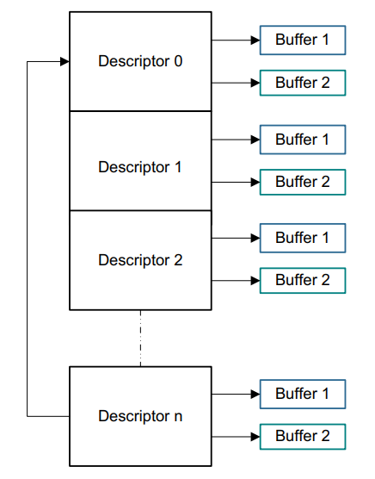
Introduction to the TC3x GETH module

Slide 17
Introduction to the TC3x GETH module
Since TC3x can have up to 4 Transmit channels and 4 Receive channels, this means that there are 4 Transmit and Receive engines or 4 Tx and Rx Descriptor lists;
There is no limit for the number of descriptors that can be used for a single packet;
DMA Channel 0
DMA Channel 1
DMA Channel 2
DMA Channel 3

Slide 18
Introduction to the TC3x GETH module
The application needs to program the total ring length, that is, the total number of descriptors in ring span in the following registers of a DMA channel:
Transmit Descriptor Ring Length Register (DMA_CH#_TxDesc_Ring_Length);
Receive Descriptor Ring Length Register (DMA_CH#_RxDesc_Ring_Length);
The Descriptor Tail Pointer points to the end of the descriptor list;
The base address and the current descriptor pointer decide the address of the current descriptor that the DMA can process;
The DMA continues to process the descriptors until the following condition occurs:
Current Descriptor Pointer == Descriptor Tail Pointer; When is condition occurs, the DMA will go into suspend mode;
The application must perform a write to the Descriptor Tail pointer register and update the tail pointer so that the following condition is true:
Current Descriptor Pointer < Descriptor Tail Pointer;

Slide 19
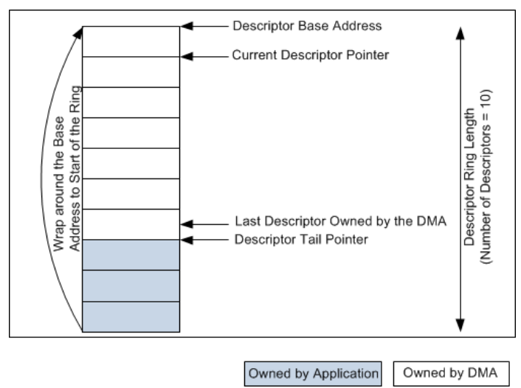
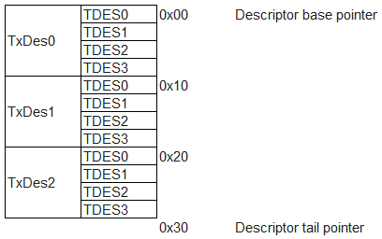
Introduction to the TC3x GETH module

Slide 20
Introduction to the TC3x GETH module
For descriptors owned by the application, the OWN bit of DES3 is reset to 0. For descriptors owned by the DMA, the OWN bit is set to 1.
If the application has only one descriptor in the beginning, the application sets the last descriptor address (tail pointer) to Descriptor Base Address + 1. The DMA processes the first descriptor and then waits for the application to advance the tail pointer.
TC3x is a little-endian machine whereas the Ethernet protocol is big-endian. This difference must be addressed inside the application.

Slide 21
Table of contents
1
TC3xx available boards
3
2
Introduction to the TC3x GETH module
5
2.1
Brief description of the GETH module
6
2.2
GETH Master/Slave AHB
12
2.3
Descriptors
14
2.4
Transmit Descriptors
21
2.5
Receive Descriptors
28
2.6
MAC Transaction Layer (MTL)
34

Slide 22
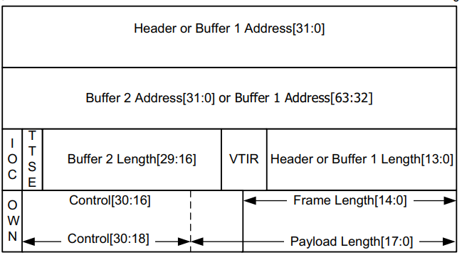
Introduction to the TC3x GETH module
The GETH module supports two types of Transmit Descriptor formats: Read and Write-back.
The GETH DMA in requires at least one descriptor for a transmit packet. In addition to two buffers, two byte-count buffers, and two address pointers, the transmit descriptor has control fields which can be used to control the MAC operation on per-transmit packet basis.
Transmit Descriptor Read Format

Slide 23
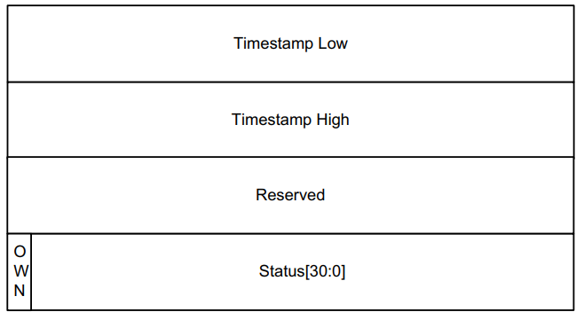
Introduction to the TC3x GETH module
The write-back format of the Transmit Descriptor includes timestamp low, timestamp high, OWN, and Status bits. If a transmit package has more descriptors the write-back format is applicable only for the last descriptor of the corresponding packet (the write back format descriptor will appear after the descriptor that has the LD bit (TDES3[28]) set.
Transmit Descriptor Write-Back Format

Slide 24
Introduction to the TC3x GETH module
After the package is transmitted, the transmit normal descriptor (Read Format) will be overwritten by the transmit normal descriptor (Write-Back Format). Hence, the information from the transmit normal descriptor(Read Format) will be lost.
Transmit Descriptor Read Format
Transmit Descriptor Write-Back Format

Slide 25
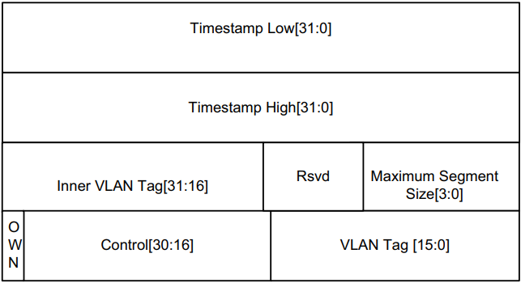
Introduction to the TC3x GETH module
The context descriptor is used to provide the timestamps for one-step timestamp correction, VLAN Tag ID for VLAN insertion feature, and SA insertion bit for SA insertion.
The Transmit Context descriptor can be provided any time before a packet descriptor. The context is valid for the current packet and subsequent packets. The context descriptor is used to provide the timestamps for one-step timestamp correction and VLAN Tag ID for VLAN insertion feature. Write back is done on a context descriptor only to reset the OWN bit.
Transmit Context Descriptor Format

Slide 26
Introduction to the TC3x GETH module
The context descriptor contains the Segment Size parameter for the TCP Segmentation Offloading for TCP/IP Packets for the upper layers.
Write back is done on a context descriptor only to reset the OWN bit.
Transmit Context Descriptor Read Format
Transmit Context Descriptor Write-Back Format

Slide 27
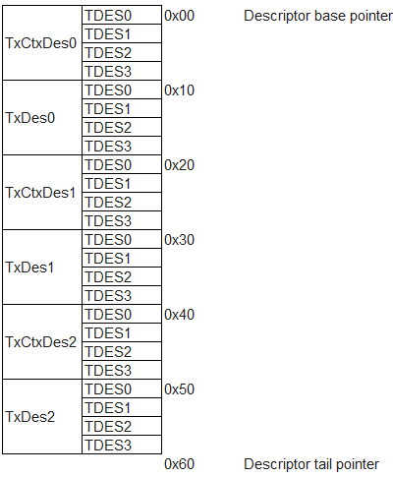
Introduction to the TC3x GETH module

Slide 28
Table of contents
1
TC3xx available boards
3
2
Introduction to the TC3x GETH module
5
2.1
Brief description of the GETH module
6
2.2
GETH Master/Slave AHB
12
2.3
Descriptors
14
2.4
Transmit Descriptors
21
2.5
Receive Descriptors
28
2.6
MAC Transaction Layer (MTL)
34

Slide 29
Introduction to the TC3x GETH module
The GETH module supports two types of Receive Descriptor formats: Read and Write-back.
There are two types of Receive Descriptors:
Normal descriptors;
Context descriptors.
The GETH module DMA attempts to read a descriptor only if the Tail Pointer is different from the Base Pointer or current pointer.
It is recommended to have a descriptor ring with a length that can accommodate at least two complete packets received by the MAC. Otherwise, the performance of the DMA is impacted greatly because of the unavailability of the descriptors. In such situations, the RxFIFO in MTL becomes full and starts dropping packets.
All RX descriptors are prepared by the software and given to the DMA as “Normal” Descriptors

Slide 30
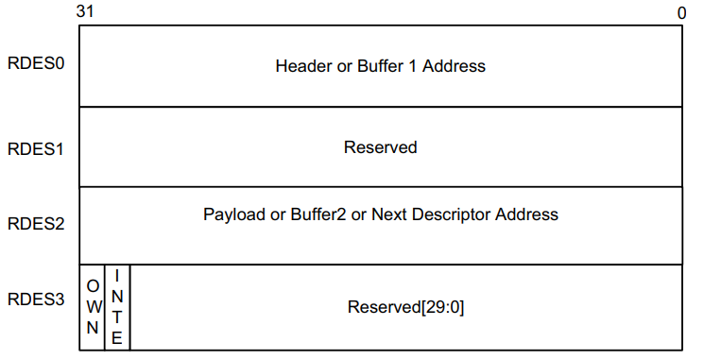
Introduction to the TC3x GETH module
Receive Descriptor Read Format

Slide 31
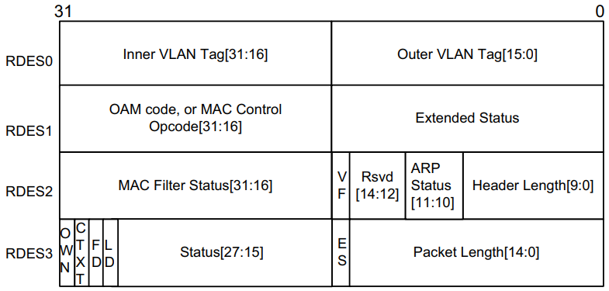
Introduction to the TC3x GETH module
The DMA reads this descriptor and after transferring a received packet (or part of) to the buffers indicated by the descriptor, the Rx DMA will close the descriptor with the corresponding packet status
The format of this status is given in the “Receive Normal Descriptor (Write-Back Format)”
Receive Descriptor Write-Back Format

Slide 32
Introduction to the TC3x GETH module
Like in the transmit case, the receive normal descriptor (Read Format) will be overwritten by the receive normal descriptor (Write-Back Format). Hence, the information from the receive normal descriptor(Read Format) will be lost.
Receive Descriptor Read Format
Receive Descriptor Write-Back Format

Slide 33
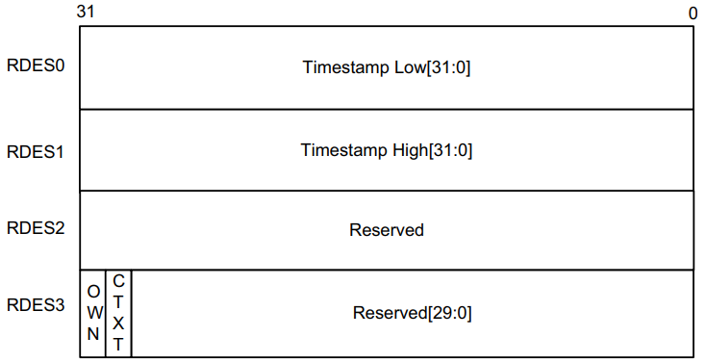
Introduction to the TC3x GETH module
The DMA can write to Receive Context Descriptor, which provides extended status related to the last receive packet.
The descriptor is read only for the application. Only the DMA can write to this descriptor. The context descriptor provides information about the extended status related to the last received packet. The Bit 30 of RDES3 indicates the context type descriptor.
Receive Context Descriptor Format

Slide 34
Table of contents
1
TC3xx available boards
3
2
Introduction to the TC3x GETH module
5
2.1
Brief description of the GETH module
6
2.2
GETH Master/Slave AHB
12
2.3
Descriptors
14
2.4
Transmit Descriptors
21
2.5
Receive Descriptors
28
2.6
MAC Transaction Layer (MTL)
34

Slide 35
Introduction to the TC3x GETH module
The TC3x GETH module uses two embedded FIFOs. The TX FIFO has a size of 4 KB, and the RX FIFO has a size of 8 KB.
Since the GETH DMA has 4 TX/RX possible channels, the 4 KB TX FIFO is shared among the 4 TX MTL queues and the 8 KB RX FIFO is shared among the 4 RX MTL queues.
The RX/TX FIFO buffer is allocated to the queues using the Receive Queue Size (RQS) and Transmit Queue Size (TQS) bitfields. The allocation is done in blocks of 256 bytes and the minimum allocation per queue can be 1 block of 256 bytes (even if the client sets RQS or TQS bitfields to zero, a 256-byte block will be allocated to the respective queues).

Slide 36
Introduction to the TC3x GETH module
Some examples of possible configurations include:
4 TX MTL active queues having 1 KB each;
2 TX MTL active queues having 2 KB each;
1 TX MTL active queue having 4 KB;
1 TX MTL active queue having 512 bytes etc..
The same principle applies to the RX side, with the mention that the total amount of FIFO buffer allocated to the RX MTL active queues must not surpass 8 KB.

Slide 37
Introduction to the TC3x GETH module
DMA
Transmit channels
Receive channels
0
1
2
3
0
1
2
3
TX FIFO (4 KB)
RX FIFO (8 KB)
TQS0
RQS0
RX DMA MAP
TQS1
RQS1
0
1
2
3
TQS2
RQS2
TQS3
RQS3
MAC
0
1
2
3
0
1
2
3
Transmit queues
Receive queues

